Slide 1



Introducing a New Application Aoi Sora
x
Proposed by AURA ORIENTALIS team

Slide 2
AGENDA
01
Aura Orientalis Introduction
02
Aoi Sora Introduction
Overview
Introduction to IT Division
Introduction to System Manager
Key Differentiators Aura Orientalis Can Deliver
Demo
Project Timeline
Discussion

Slide 3

01
Aura Orientalis Introduction

Slide 4
1. Aura Orientalis Introduction _Overview
Our mission is to create a serene and harmonious world for our customers, their communities, and the global environment through the value of our products and services.
System Development
Handicraft Products
Trading
Services
Notes:
私たちの使命は、私たちの製品とサービスを通して、お客様、その周りの人々、地球環境に、心地よい穏やかな世界を創造することです。
Sứ mệnh của chúng tôi là tạo nên một thế giới dễ chịu và yên bình cho khách hàng, những người xung quanh họ, cũng như cho môi trường toàn cầu thông qua các sản phẩm và dịch vụ của chúng tôi

Slide 5
1. Aura Orientalis Introduction _Key Differentiators Aura Orientalis Can Deliver
Technical Expertise
Solution Capabilities
Training
& Knowledge Sharing
Continuous Partnership

Slide 6









1. Aura Orientalis Introduction _Key Differentiators Aura Orientalis Can Deliver
Technical Expertise
1. Applications & Systems
2. Cloud
Platforms
3. Databases
4. Flexible Solutions
Aura Orientalis provides a solid technology foundation
— the “backbone” for sustainable business growth.

Slide 7
1. Aura Orientalis Introduction _Key Differentiators Aura Orientalis Can Deliver
Solution Capabilities
Experience of Technical Leaders & Team
Operational Understanding
.
Tailored Software Design
Notes:
Solutions come from the practical experience of our Technical Leaders and company team: many years working in supermarket and retail environments, with deep understanding of industry-specific operations
Our team has the ability to understand business operations while continuously learning to propose targeted solutions
We deliver software designs that fit real-world needs, addressing root problems rather than just handling surface issues.

Slide 8
1. Aura Orientalis Introduction _Key Differentiators Aura Orientalis Can Deliver
Training
& Knowledge Sharing
1. Commitment to Training
2. In-Depth Knowledge
3. Reduced Dependence
4. Proactive Mastery
Aura delivers knowledge and self-reliance, enabling businesses to grow sustainably without relying on external support.
Notes:
Aura provides direct training to your team on relevant operational and technological knowledge.
Not just teaching system usage, but also guiding how to build and manage a complete system.
Your business can confidently operate, modify, and expand the software in the future.
Clients don’t just “use the system” — they fully understand the technology behind it.

Slide 9
1. Aura Orientalis Introduction _Key Differentiators Aura Orientalis Can Deliver
Continuous Partnership
1. Continuous Support
2. Updates & Improvements
3. Strategic Partner
4. Sustainable Value
With Aura, clients don’t just have a technology provider — they gain a reliable partner for long-term development.
Notes:
Always ready to resolve issues arising during operations.
Systems are regularly upgraded based on real needs and emerging trends.
Aura does more than provide software — we accompany you as a trusted partner in your growth journey.
Ensures the system remains relevant, efficient, and aligned with your business’s growth.

Slide 10
02
Aoi Sora Introduction

Slide 11
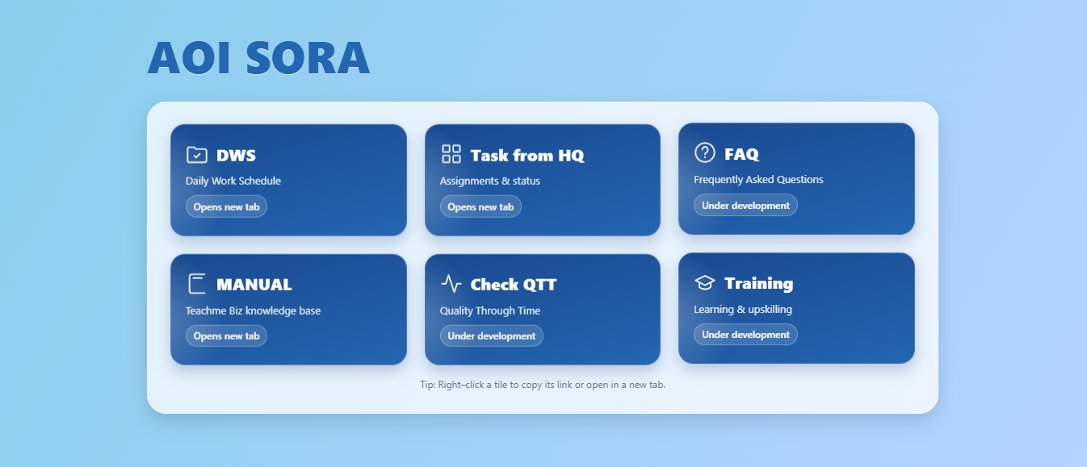
2. Aoi Sora Introduction _Introduction to the Task Management Project

Slide 12
2. Aoi Sora Introduction _Project Timeline
Oct’25
Jan’26
Nov-Dec’25
Contract signed
Final handover and system go-live
Development period (2 months after contract signing)

Slide 13
Thanks!_
Do you have any questions?
giatu.le@auraorientalis.vn
+84-367-827-577
Auraorientalis.vn

